Slide 1
ZS Campus Beats 2021 Case Challenge
This document is solely for the use of client personnel. No part of it may be circulated, quoted or reproduced for distribution outside of the client organization without prior written approval of ZS.

Slide 2
Team details
Team Name | DIVERGENT
College Name | INDIAN INSTITUTE OF TECHNOLOGY GUWAHATI
Team Leader | TATHAGATA BHOWMIK
Team Member 2 | NILAY PANDEY
Team Member 3 | HRITHIK KUMAR VERMA

Slide 3
Scenario THREE – BUSINESS TECHNOLOGY

Slide 4

Business Technology
OVERVIEW
01
Pulse Beverages, a leading nutrition drink manufacturer and seller in the US introduced its unique drink Aqua which despite being well established, is facing the problem of increasing manufacturing cost and lower profit.
02
Keeping up with the trend, management installed TechproX, a new IT system capable of recording price and discount offered for each product as well as track sales for aqua and also manages the customer loyalty program.
03
ZS is required to come up with a structured approach to all the questions.

Slide 5

PART-1
This report contains the bill amount, invoice number, number of discounted items, and also accounts for specific customers who has subscribed to store’s loyalty program or not.
Overview
Marketing Report-1
Assessing Data Tables and Creating Reports.
It captures the number of invoices, total quantity of the item, a flag to indicate if the item was on offer or not, average quantity of the item sold on any day, when it was offered on discount, when it was not offered on discount.
Marketing Report-2

Slide 6
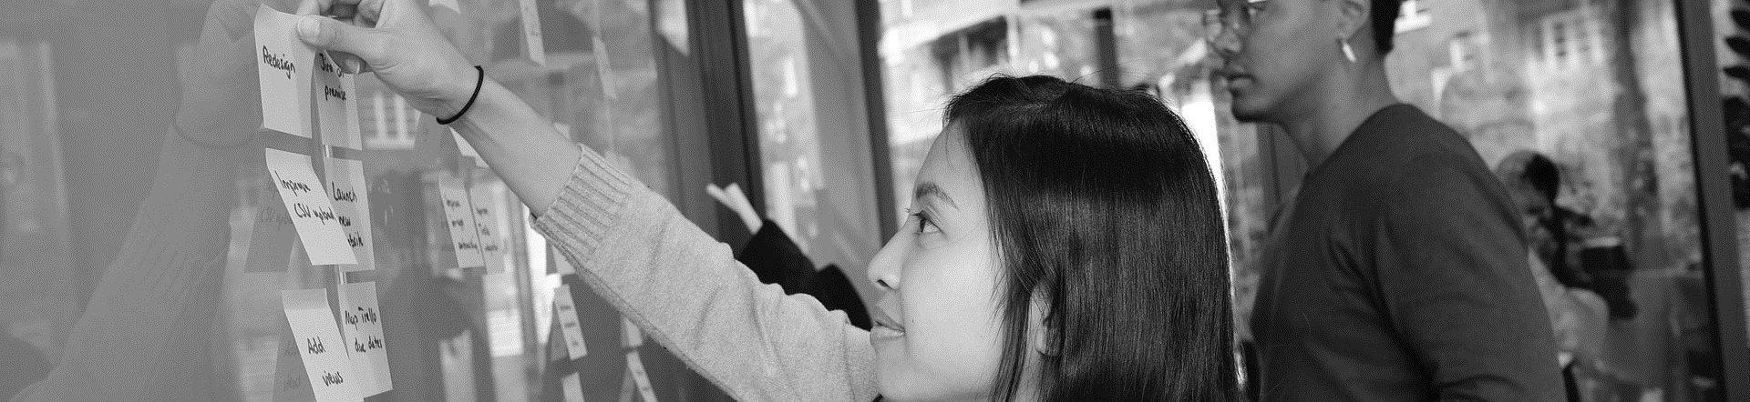
PART-1
For Report 1 , Assuming All the Table1,Table 2, Table3, Table 4, Table5 are added to the SQL Database.
Tables and Columns Required- Table1(Invoice Number, Date, Time, Customer Loyalty Card No.), Table 2( Invoice Number, item Number, item Quantity), Table 4( date, item No., price per unit), Table 5( date, item No., discount %)
Create a Table
Joining Table
Number of Discount Item and Loyalty of Customer
Total sales and discount
Creating a table having columns Date, Time, Invoice Number, Bill Amount,# of Discounted Items, Is Loyal Customer, with the help of Create Table command in SQL
Importing Date, Time, Invoice Number from Table 1by INSERT INTO command in the table
Joining Table 1 and Table 2 by LEFT JOIN on condition Invoice Number. Now Join this table with Table 4 on condition Date. Again LEFT JOIN this table with Table 5.
Now Bill= (1- discount percentage/100) * Price per unit* Item Quantity.
GROUP BY Date, COUNT Discount percentage. This is the number of discounted items
GROUP BY Invoice Number, COUNT Customer Loyalty Card No. as value.
WHEN value=1, INSERT ‘Y’ in ‘Is Loyal Customer’ else ‘N’
Total Sales= SUM of Bill Amount
(assuming Total Sale= Net Sale)
Total Discount Offered- SUM of =(Discount Percentage/100)* Price Per Unit* Item Quantity
.

Slide 7
PART-1
For Report 2 , Assuming All the Table1,Table 2, Table3, Table 4, Table5 are added to the SQL Database.
Tables and Columns Required- Table1(Invoice Number, Date), Table 2( Invoice Number, item Number, item Quantity), Table 4( date, item No.), Table 5( date, item No., discount %)
On Discount
Average quantity sold
Create a Table
GROUP BY
Creating a table having columns Date, # of Invoices, Quantity Sold, On Discount? , with the help of Create Table command in SQL
Importing Date from Table 1by INSERT INTO command in the table
Left JOIN Table 1 and Table 2 on Condition Invoice Number. Using WHEN for Particular Item Number, we GROUP BY Date to find the ‘# of Invoices’ by COUNT Command on Invoice Number, and SUM on Item Quantity to find Quantity Sold
Using WHEN command on Item No. in Table 5, GROUP BY Date, count the number of Discount Percentage and store it in a table. Now LEFT JOIN this table with existing table. Fill ‘On Discount’ in Report table when Count !=Null, then Y, or else N.
GROUP BY Date, when Count of the Number of Discount Percentage != Null, The average quantity sold= COUNT Item Quantity/ COUNT Date.
when Count of the Number of Discount Percentage = Null, The average quantity sold= COUNT Item Quantity/ COUNT Date.
Average Quantity Sold per day= Quantity Number / COUNT Date.

Slide 8
PART-2
Overview
This report captures following information for a particular size combination on a daily basis : Invoice number for each sale, Product size and flavor details and a flag to indicate if a particular item was offered on discount on thar date.
1.
Sales Inventory Report Data
2.
ZS is required to perform data analysis and provide solutions to each problem.

Slide 9
PART-2
Q1. Listing all the data checks to be apply to the data and identifying different issues that could have significant impact on the reports generated.
Assumptions: Assuming all the data are being recorded and stored by TechproX.
Data Integrity
Data consistency
Data validation
Regular security and maintenance check of the TechproX to ensure its proper functioning.
Checking for missing, duplicate, and invalid values.
Exploring and inspecting the data for all the outliers and thereby fixing it.

Slide 10
PART-2
Q2. Suggest a way to improve the data structure to be able to store and process the data in a better way.
Modifying existing data table
Generating a new table
Replacing values in “Discounted” column by actual discount percentage offered to each product type thus removing all the irrelevant information.
A new revenue table can also be generated consisting of column namely: “Item quantity”, “Selling price” and “Revenue generated”, where revenue = selling price*quantity(#)

Slide 11
PART-2
Q3. Additional data to outsource from vendors which will help in improving tha data analysis and help generate more revenue for Aqua
Revenue Segmentation as per product type and its flavour.
Data showing market share on the basis of different product type to channelize the cost.
Revenue segmentation based on geographical distribution
Acquiring data related to customer division based on product flavour which helps in targeting a specific audience.

Slide 12
THANK YOU! ☺

